Slide 2
CONTENTS
Event Factsheet
Race Day Schedule
Race Kit Essentials
Transition
Venue Information General Information
Race Leg Information
Overall Site Maps & Route Info
Medical Safety
Par-Q & You
Rules and Regulations

Slide 3
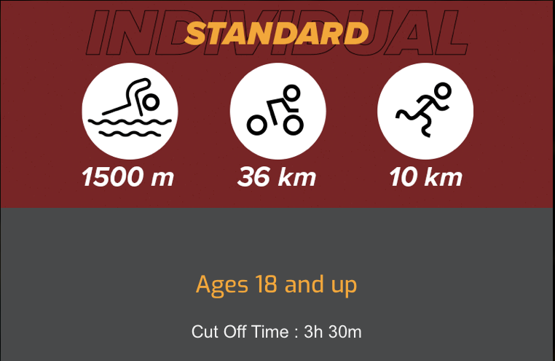
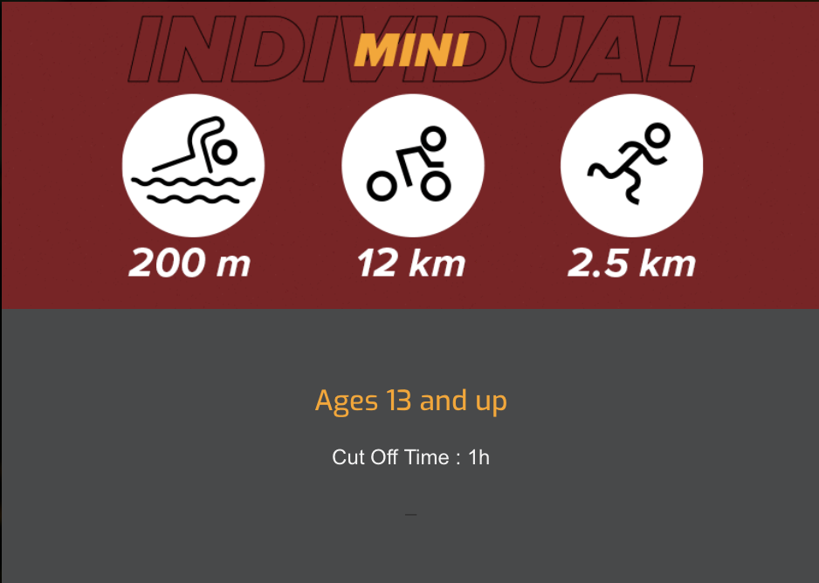
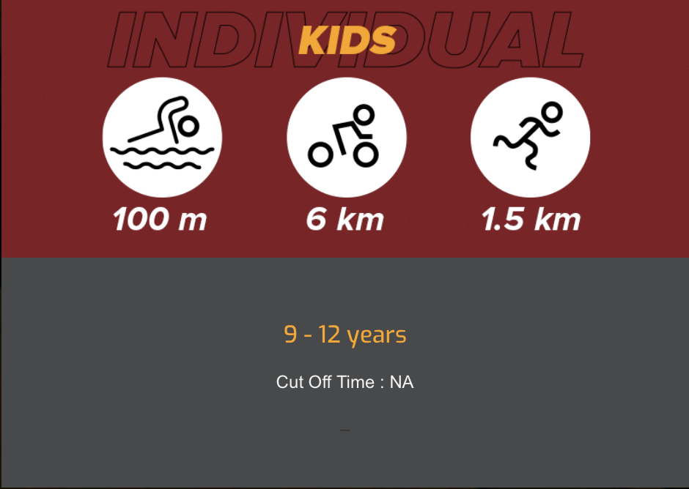
EVENT FACTSHEET
EVENT DETAILS
Date : 16 April, 2023, Sunday
Venue : East Coast Park, Angsana Green, CP E2
Time : 6:00am - 1:00pm
Website : www.trifactor.asia | Enquiries : enquiry@trifactor.asia
FB : TriFactor | IG : trifactor_series
CATEGORIES & AGE GROUPING
CIRCUIT CLOSURES / CUT OFF TIME
SWIM CIRCUIT - 11.00am
BIKE CIRCUIT –
12.30pm
RUN CIRCUIT –
1.30pm
All participants are expected to finish each Leg before the circuit closes.
CUT OFF TIME 4H 30MIN
18 - 29
30 - 44
45+
CUT OFF TIME 2H 30MIN
16 - 29
30 - 44
45+
CUT OFF TIME 3H 30MIN
18 - 24
25 - 29
30 - 34
35 - 39
40 - 44
34 - 49
50 - 54
55 - 59
60+
CUT OFF TIME – 1 HOUR
13 - 15
16 - 39
40+
CUT OFF TIME - NA
9 - 12
11 - 12

Slide 4
RACE DAY SCHEDULE
Start Times | Wave | Category | Race Bib No. / Capacity | Cap Colour
6.00am | Opening of Transition Area
[National Super Sprint Championships Race] Super Sprint Category: 300m (Swim) + 6km (Bike) + 2km (Run)
7.00am | NTC | National Super Sprint Championship – Mixed | 01 – 50 | White
Extended Category: 2.25km (Swim) + 42km (Bike) + 15km (Run)
7.30am | Club Challenge | Club Challenge Invitation | 51 - 70 | Red
7.35am | 1 | Extended – Male – All Age Groups | 101 – 1XX | Red
7.45am | 2 | Extended – Female All Age Groups | 174 – 19X | Red
 |  | Extended Team Relay – Mixed | 195 – 19X | Red
Standard Category: 1.5km (Swim) + 36km (Bike) + 10km (Run)
8.15am | 3 | Standard - Male 18 – 29yrs, 30 – 39yrs | 201 – 276 | Blue
8.20am | 4 | Standard - Male 40 – 49yrs | 277 – 354 | Blue
8.25am | 5 | Standard – Male 50 – 59, 60+ | 355 – 400 | Blue
8.35am | 6 | Standard – Female All Age Groups | 401 – 4XX | Blue
 |  | Standard Team Relay - Mixed | 451 – 45X | Blue
Sprint Category: 750m (Swim) + 18km (Bike) + 5km (Run)
9.00am | 7 | Sprint - Male 18 – 44yrs | 501 – 578 | Yellow
9.10am | 8 | Sprint – Male 45+ | 579 – 61X | Yellow
9.20am | 9 | Sprint - Female All | 621 – 65X | Yellow
 |  | Sprint Relay Team – Mixed | 658 – 66X | Yellow
Mini Category: 200m (Swim) + 12km (Bike) + 2.5km (Run)
10.00am | 10 | Mini – Male All | 701 – 734 | White
10.10am | 11 | Mini – Female All | 735 – 75X | White
Kids Category: 100m (Swim) + 6km (Bike) + 1.5km (Run)
10.25am | 12 | Kids – Male 9 - 10 | 801 - 822 | Orange
10.30am | 13 | Kids - Male 11 - 12 | 823 – 8XX | Orange
10.35am | 14 | Kids – Female 9 - 10 | 851 – 856 | Orange
10.40am | 15 | Kids – Female 11 - 12 | 857 – 8XX | Orange
TriFactor Cares Resilience Run
10:40am | 1.5km | 1.5 km Resilience Run
11.30am | Start of Prize Presentation
1.00pm | End of Event
* Schedule is subject to changes

Slide 5
EVENT FACTSHEET
PRE-RACE : RACE PACK COLLECTION
VELOCITY @ NOVENA SQUARE
Date : 8/9 Apr (Sat/Sun), 11am to 8pm
Pickup Race Pack consisting of :
Race Bib, Race Tattoo, Swim Cap, Bike Helmet, Bike Tag (Refer to next pg)
Event Tee
RACE DAY PREP
EAST COAST PARK, ANGSANA GREEN (CP E2)
Date : 16 Apr (Sun), 6am to 1pm
Pickup Timing Chip from Information Counter
Ensure your Race Kit is worn properly
Prepare your Transition Area
Warm up and prepare for your Race
Arrive in your Swim Gear @ Swim Start Line 15min prior to your Wave time
POST RACE
Collect your Finisher Medal
Return your Timing Chip @ Finish Area
Grab your post-race hydration & banana
Hang out with us for the Awarding ceremony & check out our partner events at the event site!

Slide 6
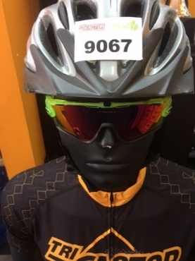
RACE KIT ESSENTIALS
TRANSITION | SWIM | BIKE | RUN
Arrive to prepare your Transition 1h prior to your Wave Enter Transition with your Wrist Tag Locate your Transition Spot (marked out with your Bib number on the metal Bike Rack) Park your Bike & prepare your Transition essentials within the space allocated to you Keep your Transition space as neat as possible. All items must be kept within a 50cm x 50cm space around their allocated space so as not to impede the safe movement of other participants. Leave Transition to standby @ Swim Start Line in your Swim gear 15min prior to your Wave Flag-Off | Wrist Tag
 | Reusable Timing Chip (on LEFT Ankle)
 | Bib Number Tattoo (LEFT Arm)
 | Swim Cap
 |  | Race Bib (attached to the front of your apparel by pins, or by Race Belt) + QR Code Sticker
 |  | Bike with Bike Tag (Around Bike Post)
 |  | Helmet with Helmet Tag + QR Code Sticker

Slide 7
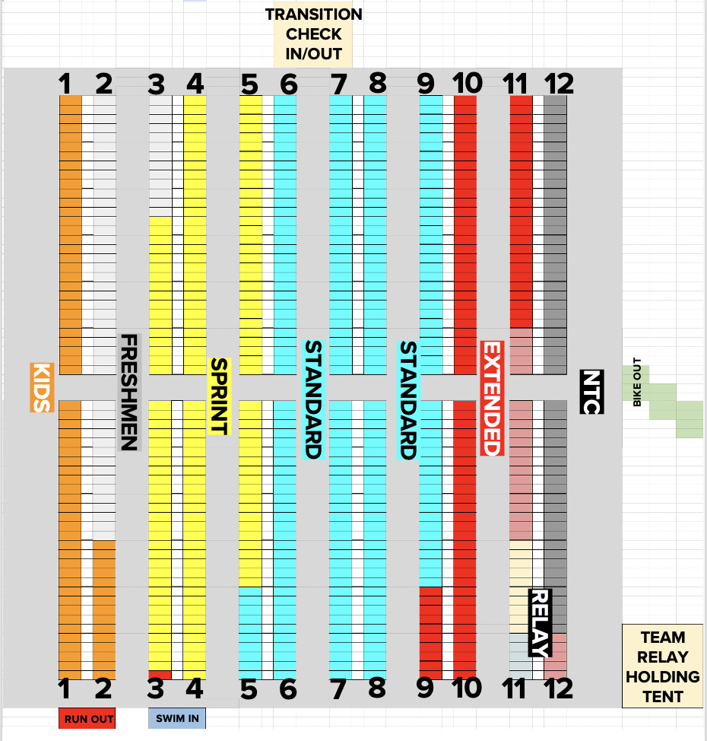
TRANSITION ZONE

Slide 8
EVENT FACTSHEET
STAGGERED FLAG-OFF TIMINGS
Participants from different race distances will start off at different time.
Please refer to the event schedule for the respective flag-off timing.
RACE BIBS & WRIST TAGS
Always display your issued Race Bib on the front of your adorned apparels during Run legs of the race.
Participants without a Race Bib will not be allowed to race.
Individual medical information on the back of the race bibs must be completed prior to the start of the race.
All Participants must wear their wrist tags at all times.
TIMING CHIP
For all participants, you will have an ankle-strap Multi-sports Tag to be worn around your left ankle during the race to capture your race timing.
For Team relays, the transferrable ankle strap Multi-sports Tag is provided and is to be worn on the ankle and passed on to your team member in the relay holding area.
At the Finish line, all participants & teams must return their Timing Tag.
Lost Timing Tags are chargeable at S$50.
No Timing Chip = No Results
BODY MARKING
Temporary Race Tattoos will be provided.
These need to be applied BEFORE entering Transition for setup
ROAD CLOSURE
Part of East Coast Park Service Road will be closed to traffic on event day from 6am to 1pm. This is to facilitate the cycling leg of the event. The closure will commence from East Coast Park Expressway towards Bedok (Exit 7A) until the turning point of the cycling route (National Sailing Centre).
Participants are advised against parking their vehicles at the carparks within the road closure areas.

Slide 9
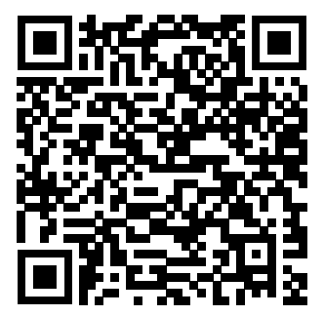
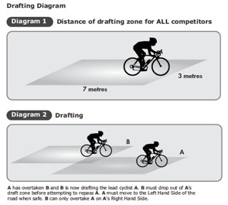
EVENT FACTSHEET
BIKE RENTAL
For those who pre-ordered their bikes, collect your Bike from collection station from 0600h on race day.
A photo ID is required for verification.
All bikes must be returned before 1200h.
Extra charges will be incurred for any damages or losses
Last minute bookings available - scan here :
BIKE MECHANIC SERVICES
Our Official Bike Servicing Partner, BB Bikes, will be onsite at the event area for any last minute Bike related issues.
NON-DRAFTING RACE (Bike Leg)
This is a non-Drafting Race. Participants need to be out of the drafting zone of another participant during their bike leg.
The drafting zone is defined as a rectangular area 7 meters long (23 feet) by 2 meters wide (6 feet 6 inches) surrounding each bicycle. The longer sides of the zone begin at the leading edge of the front wheel and run backward parallel to the bicycle; the front wheel divides the short side of the zone into two equal parts, each being one meter wide.
A participant may enter the drafting zone of another cyclist without penalty, if he or she enters the drafting zone from the rear, closes the gap and overtakes the leading cyclist all within no more than 15 seconds. Anyone caught longer in the draft zone will face a penalty.

Slide 10
EVENT FACTSHEET
TEAM RELAY
All Team Members must wear their Wrist Tags throughout the race.
Each member should have the following on during their race :
Swim – Bib Number Tattoo + Swim Cap
Bike – Race Bib + Bike with Tag + Helmet with Tag
Run – Race Bib
All Cyclists and Runners must wait at the Relay Holding Area (located in Transition) for their previous teammate to return to pass on the timing chip to them.
Members are responsible for being on standby for their returning member for the Timing chip handover.
Anyone caught leaving the transition area before their teammate returns will be disqualified immediately without appeal.
Cyclist are not allowed to wear their helmet or pick up their bicycles before receiving the timing tag.
Runners are not allowed to take the timing tag before the cyclist racks their bike and takes off their helmets.

Slide 11
EVENT FACTSHEET
RESULTS & TIMING Provisional Race results will available within 4hrs of the end of the event. Please note that the race timings will be further validated and the finalised results will be published on our website within 48hrs.
A $50 deposit is required for any appeals which will be returned if the appeal is successful. Please note that the race timings will be further validated and the finalised results will be published on the website within 24 - 36hrs after the event. Results will be based on gun time.
AWARD CATEGORIES & PRIZES
Top 3 winners from each Age Group and Category will be presented with Awards. Winners are advised to be present, or to field a representative to collect on behalf of them for the prize presentation on Race Day. Uncollected prizes will be held at our office for 1 month after which will be donated.
E-CERTIFICATE
E-Certificate will be available for download 48hrs after the event at the results page. Look out for the icon next to your results. Do refer to our social media for updates!
PHOTOGRAPHY
The 2 QR codes in your Race Kit must be attached to your Helmet and Race Bib for us to catch your photo. Remember to look out for our photographer as you race through the finish line! Your photos will be available for viewing 5 days after the race. Do refer to our social media for updates.
Event pictures will also be made available on the event website and social media pages. Family members and supporters are also welcomed to take pictures.

Slide 12
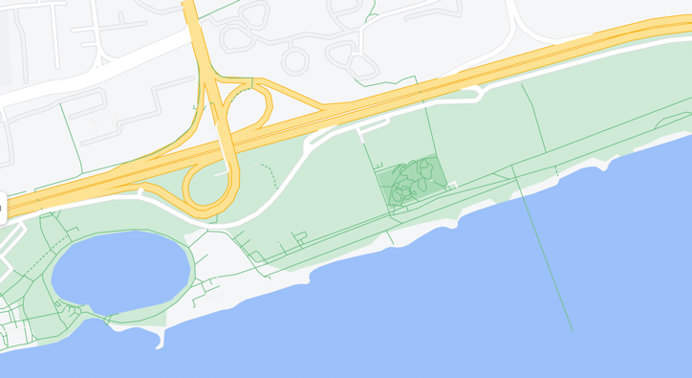
VENUE INFORMATION
GETTING THERE : CAR
Head towards East Coast Park Expressway. Turn off at Exit 7A.
Make a RIGHT turn when entering East Coast Park Service Road.
Nearest parking available is at carpark E2 or E3.
Due to the high volume of traffic, please note that parking will be limited.
CP F2 and G will be closed from 6am to 1pm.
GETTING THERE : PUBLIC BUS
Buses 10, 13, 14, 43, 48 - Upper East Coast Road
Buses 31, 43, 48, 55, 155, 196, 197 – Marine Parade Road
GETTING THERE : MRT
Closest MRT - Bedok MRT Station (East West Line)
EAST COAST PARK
ANGSANA GREEN
XTREME
SKATE PARK
CP E1
CP E2
LAGOON
FOOD
CENTER
WAKE
PARK

Slide 13
GENERAL INFORMATION
BAGGAGE STORAGE
Participants can store their excess baggage at the Baggage area.
Participants are advised to pack light and refrain from bringing too many valuables.
TOILETS & SHOWERS
Toilets & showers are available at the public restrooms.
Nearest public restrooms are located next to Aloha Sea Sports Club@ Area E and Xtreme Skate Park @ Area F.
HYDRATION POINTS
There will be water points at Swim and along the Run route.
However, in pursuit to achieving zero-waste at our events, we strongly encourage you to bring your own water bottle and top up at the refueling stations.
MEDICAL SUPPORT
A medical station is located at the Event site to ensure that participants can get medical attention quickly and efficiently whenever required.
Mobile Medics will be deployed along the course for those that require any attention. Lifeguards and Kayakers are lined up along the Swim course for assistance.
If you are not feeling well, please approach any race crew or medical staff for immediate attention.
RACE OFFICIALS & TF CREW
There will be Race Officials and TF Crew at the event cheering on the participants
throughout the race. If you require any assistance during the event, feel free to approach any one of us and we will gladly assist you.

Slide 14
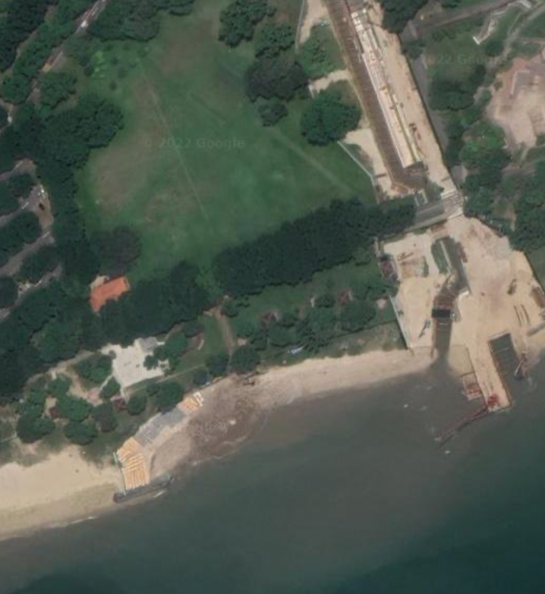
MAIN EVENT SITE
ANGSANA GREEN (E2)
TRANSITION CHECK IN
TRANSITION
TOWARDS BIKE ROUTE
BIKE IN/OUT
RELAY HOLDING
FINISH
RUN OUT
TOWARDS RUN ROUTE
SWIM OUT
LEGEND
 | START
 | FINISH
 | INFORMATION
 | TIMING CHIP PICKUP
 | BAGCHECK
 | BIKE RENTAL
 | BIKE MECHANIC
 | AWARD TENT
 | MEDICAL
 | TOILETS
 | WATER POINT
START
START
FINISH
SWIM COURSE

Slide 17
BIKE ROUTE

Slide 18
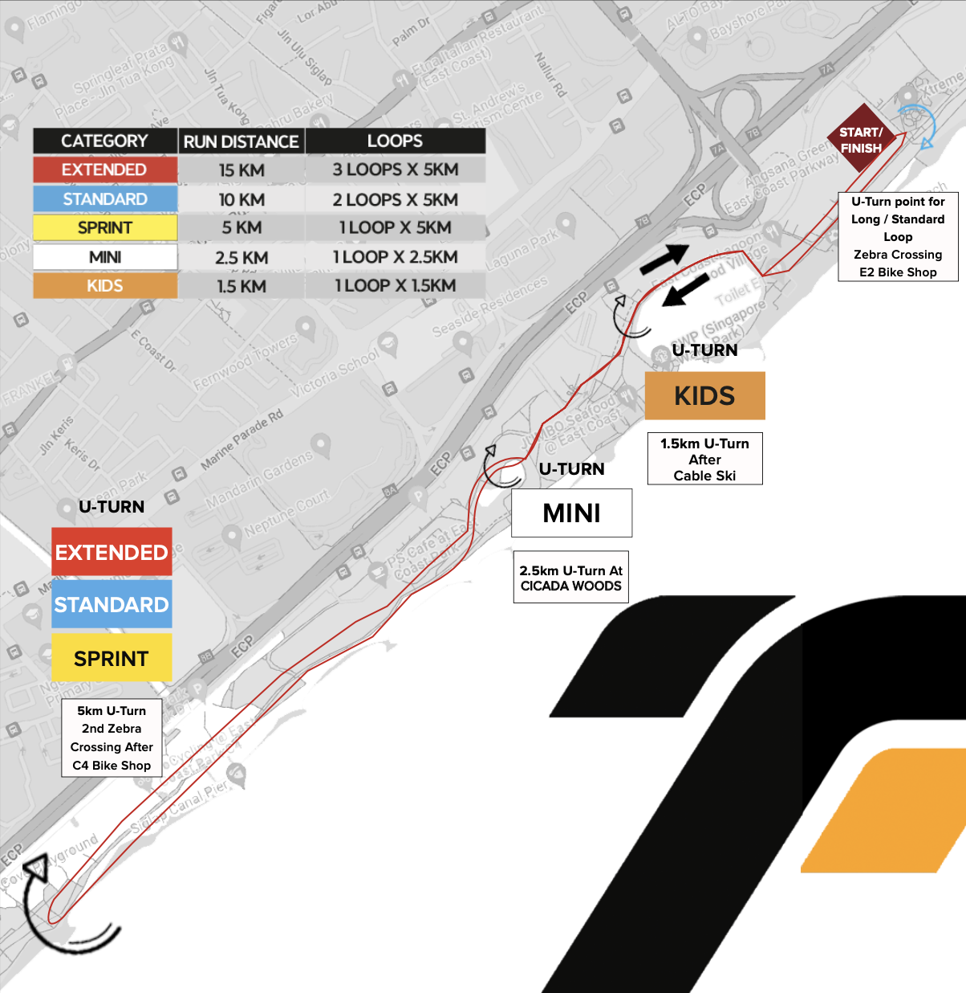
BIKE ROUTE

Slide 19
RACE INFORMATION
SWIM
All participants must wear the Swim Cap, Tattoos & Wrist tags provided by the Organisers.
Swim goggles may be worn.
All swimmers must have their Bib numbers tattoos on their LEFT arms.
Fins, paddles, snorkels or any other swimming aids are not allowed.
Swim Buoys are allowed, but participants will be placed at the back of their wave.
Wet suits are not allowed.
Support crew are not allowed. Any assistance, other than medical aid received during the swim will result in immediate disqualification.
No persons other than the participants and officials are permitted in the swimming area.
Participants in difficulty shall signal by raising an arm to the escorting kayaks for assistance.
Once assistance is rendered, the participant must retire from the competition.
In the event of unforeseen circumstances (weather, safety issues), the Organizers reserve the rights to change the event to a Duathlon.

Slide 20
RACE INFORMATION
BIKE
Participants must ensure that their Bib Numbers are clearly visible on the front of their adorned apparel at all times.
No bare torso is allowed at all times.
Participants will need to push their Bikes from Transition to the Mounting Line. Mounting of the Bike can only be done after the Mounting Line.
Participants need to Dismount before the Dismounting Line. Bikes will need to be pushed back into Transition.
Participants are to ride in single file on the left side of the road except when passing another participant and are reminded to observe traffic rules at all times.
It is the participants’ responsibility to ensure that their Bike and bakes are in good working condition. Bike mechanic services are available onsite.
All participants will be required to perform their own repairs if their Bike should break down on course.
Support vehicles and crews are not permitted.
Helmets must be worn from the time the participants remove their bicycle from the rack.
The helmet must stay on the participant’s head until he/she has placed his/her bicycle at the allocated spot on the bicycle rack.
Wearing headphones is not allowed at all times. Communication or entertainment devices of any type are strictly prohibited during competition.

Slide 21
RACE INFORMATION
RUN
Participants must wear their Bib Numbers clearly visible on their adorned apparel at all times.
Support vehicles or pacers are not allowed.
Participants must run on the designated path for the entire route. Failure to do so may result in disqualification.
No bare torso is allowed at all times.
Wearing headphones is not allowed at all times. Communication or entertainment devices of any type are strictly prohibited during competition.
Please note that the route will still be opened to public users. Kindly be mindful of public users during the race.

Slide 22
RACE INFORMATION
TRANSITION
Participants are required to keep their Transition space as neat as possible. All items must be kept within a 50cm x 50cm space around their allocated space so as not to impede the safe movement of other participants.
All non-essential bags or items must be brought out of the transition area and stored at the Baggage counter.
No public nudity is allowed as any breach will result in Disqualification.
Each participant must have the Bike helmet securely fastened on their head prior to un-racking their bike to commence the Bike leg.
Each participant must have their Bike helmet securely fastened on their head until they have racked their Bike prior to commencing the run leg.
Bikes must not be ridden in Transition at any time.
Wrist bands must be worn at all times within the transition area. Any one found without a wristband will be ushered out of the Transition area.
All relay Team members : Report to Team Holding Area next to the Transition area to do the exchange of the timing chip from one member to the next.
Only 1 parent/guardian will be allowed within the Transition Area. They may only enter when accompanied by the participant. A wristband with matching Bib number must be worn to allow access. Parents/guardian will only be allowed in before and after the race.

Slide 23
MEDICAL SAFETY
MEDICAL SAFETY & FIRST AID
Even though you may have read our medical advice before, we would like to insist that you read it again. Awareness of the health risks of exercising in a tropical climate is the best prevention for serious injuries!
MEDICAL CONDITIONS
If you have a medical condition that may affect your safe participation in exercise, please ensure that you have explained your exercise plans to your doctor and sought his/her clearance. You should not be taking part in this sport event unless medical clearance has been given to you.
MEDICATION
Should you have an allergy of some sort (e.g. to bee stings), and if you have any medication such as an auto-injector, you may want to place this in a Ziploc bag with your name & race number on it. Then pass this to the medical team so that it is on standby for you should it be needed. If you are currently taking medication for a medical condition, do ensure that you take this as prescribed to you by your doctor. Please be aware that some medications such as drugs for inflammation and injury (anti-inflammatory) may lead to dehydration. It is important for you to maintain good hydration before and throughout the event.
ILLNESS
Some illnesses may result in dehydration, salt imbalance, or disturbances to your heart function. These include viral illnesses such as the flu, as well as food poisoning and diarrhea.
If you have had such illnesses within the last 7-10 days before this event, please
assess your current fitness and if you are not feeling well, do NOT participate in the race. If you have had a fever with muscle aches in the past week before the event, it is recommended that you do not race. Diarrhea can cause loss of water and salts, so please ensure that you have replaced these before racing (using a sports drink is very helpful). If you have had a recent illness and are going to participate in the race, please start out cautiously and lower the intensity of your physical exertion.
HEAT INJURIES
Exercise in Singapore’s high heat and humidity places you at risk of developing a heat injury. In its most severe form – heat stroke – this may be potentially fatal. The best way to avoid such injuries is to ensure good physical conditioning prior to this race, and to participate within your fitness limits. Proper hydration is essential and seeks to ensure you are hydrated before the race, maintained during the race (drinking during the run phase), and then replaced after the race to prepare for your next training session!! A good beverage to use would contain water, carbohydrates (energy source) and salts, as you would find in a sports drink. If you use a sports drink, this is best consumed alongside an equal amount (or more) of water.
If you experience any of the following, please reduce your physical effort, and if you do not feel better, stop and seek medical attention:
• Undue shortness of breath • Dizziness, giddiness, light-headedness • Chest pain
• Undue tiredness, nausea • Disorientation, confusion

Slide 24
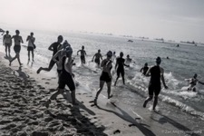
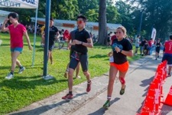
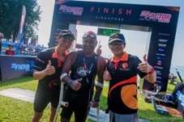
PAR-Q AND YOU
Before you take part in any physical activity, please answer this Physical Activity Readiness Questionnaire (for participants aged 15 and above).
Please answer the questions honestly and consult your doctor before taking part in the race if you answer YES to any of the 7 questions.
Has your doctor ever said that you have a heart condition and that you should only do physical activity recommended by a doctor?
Do you feel pain in your chest when you do physical activity?
In the past month, have you had chest pain when you were not doing physical activity?
Do you lose your balance because of dizziness or do you ever lose consciousness?
Do you have a bone or joint problem that could be made worse by a change in your physical activity?
Is your doctor currently prescribing drugs for your blood pressure or heart condition?
Do you know of any other reason why you should not do physical activity?
For more information about taking part in sports safely, visit the Sports Singapore website.

Slide 25
RULES & REGULATIONS
The Organisers reserve the right to amend the Rules & Regulations without prior notification.
The Organisers reserve the right to amend the race course without prior notice to the participants.
In the event of inclement weather, the Organisers reserve the right to delay the commencement of the race, shorten the race, or modify the course.
Should the inclement weather persist after the delay, the Organisers reserve the right to cancel the race without any refund of registration fees.
Whilst every reasonable precaution will be taken by the Organisers to ensure participants’ safety, participants participate at their own risk and the Organisers shall not be liable for any loss and/or damage, whether personal or otherwise, and howsoever arising. Participants are strongly encouraged to go for a medical examination and/or consult their medical practitioner prior to registration and before the actual race day.
The Organisers reserve the right to remove any participant deemed physically incapable of continuing the race. Medical personnel have the ultimate and final authority to remove a participant from the race if the participant is judged to be physically incapable of continuing the race without the risk of serious injury to themselves or others. Medical transport of any participant will result in disqualification.
On-the-spot entries will not be accepted.
The Organisers reserve the right to limit and refuse entries without giving any reason.
Upon completion of the entry form, including online registration, evidences the participant’s agreement to abide by the Rules and Regulations of TriFactor Singapore.
Once the registration has been processed, there will not be any refund for the participants, who for whatever reason, eventually do not take part.
11. The Organisers will not be responsible for any disputes arising from incomplete and/or incorrect entry details given by the participants.
12. Race entries are non-transferable. Any person doing so will be held responsible in case of an accident arising from or provoked by the other person during the race. The Organisers reserve the right to exclude both parties from future events.

Slide 26
RULES & REGULATIONS
13. Age category is determined by the participant’s age on 31 December 2023.
14. The Organisers reserve the right to use any photograph, motion picture, or any other recordings of this race and its participants for any legitimate purpose, including commercial advertising.
15. A S$50 penalty applies for any loss of the Timing Chip required for replacement.
16. The Organizers will not be responsible for any inaccuracy in participant’s race timings.
17. The details on the reverse side of the Race Bib must be filled in to enable the Organizers to contact participant’s next-of-kin in case of emergency.
18. Participants who commence before the actual start time of his/her Race entered for will be disqualified. (Please refer to start time of each race.)
19. A grace period of 15 minutes after the commencement of the race will be given for latecomers. Anyone who reports later than this grace period will not be allowed to participate in the race.
20. All participants shall be ready and assembled at the Swim Start Holding Area 15 minutes prior to the Race. Any participant that starts in the wrong wave, will automatically be disqualified.
21. There may be (generous) time limitation, which is still to be determined. Road closure will be lifted after the time limitation. Participants will then continue on the footpath at their own risk.
22. For prize winners or possible prize winners, disputes and appeals must be made on-the-spot with a S$50 refundable deposit (if the dispute is qualified) within 12hrs of the published results or whichever is earlier.
23. For all other participants, disputes and appeals regarding the results must be submitted in a written format, including electronic mail within 7 days of race day. After which, the Organizers reserve the right not to entertain any dispute or appeal.
24. Any dispute arising from the participation in the Event shall be referred to Arbitration to be conducted in Singapore under the law of the Singapore Arbitration Court.

